Slide 1

Web Engineering
HTML Layout

Slide 2
Types of HTML Elements
Block-level HTML Elements
A block-level element always starts on a new line and takes up the full width available
The <div> element is a block-level and is often used as a container for other HTML elements
the block-level element contains inline elements.
Inline HTML Elements
An inline element does not start on a new line and it only takes up as much width as necessary
The <span> element is an inline container used to mark up a part of a text, or a part of a document
An inline element cannot contain a block-level element!
There are two display values: block and inline

Slide 3
Block-level Elements in HTML
<div>
<p>
<form>
<h1>-<h6>
<header>
<hr>
<li>
<ol>
<table>
<ul>

Slide 4
Inline Elements in HTML
<a> <b> <br> <button> <cite> <em> <i> <img> <input> <label> <script> | <select> <span> <strong> <sub> <sup> <textarea>

Slide 5
HTML class Attribute
The HTML class attribute is used to specify a class for an HTML element.
Multiple HTML elements can share the same class.
To create a class; write a period (.) character, followed by a class name. Then, define the CSS properties within curly braces {}:

Slide 6
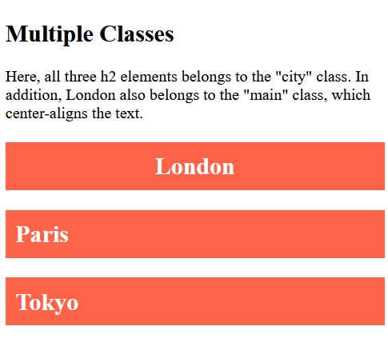
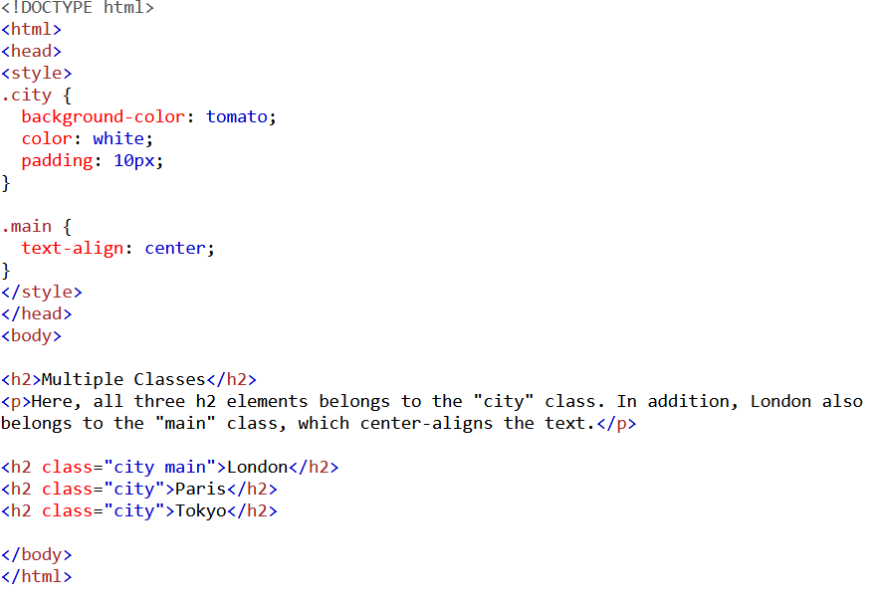

Example

Slide 7
HTML id Attribute
The HTML id attribute is used to specify a unique id for an HTML element.
You cannot have more than one element with the same id in an HTML document.

Slide 8
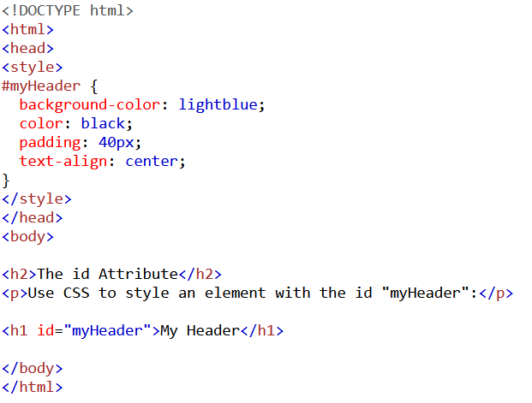
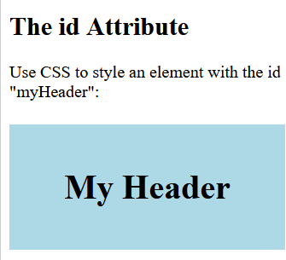
Example

Slide 9
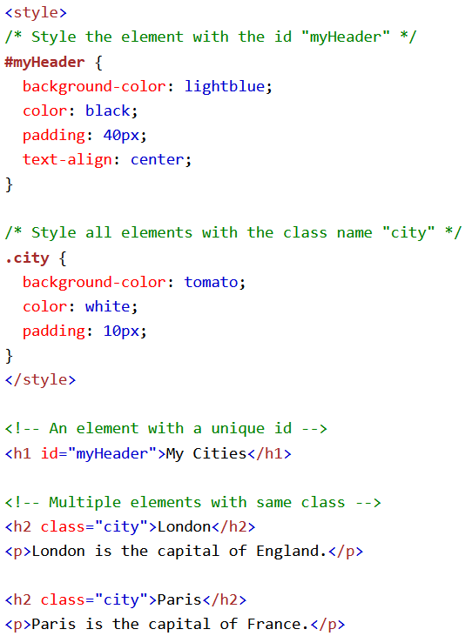
id and class
A class name can be used by multiple HTML elements, while an id name must only be used by one HTML element within the page.

Slide 10
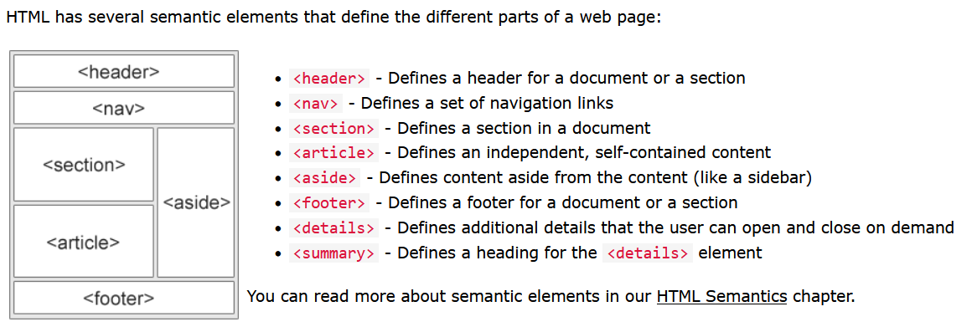
HTML Layout Elements

Slide 11
CSS Layout - The display Property
The display property is the most important CSS property for controlling layout.
The display Property
The display property specifies if/how an element is displayed.
Every HTML element has a default display value depending on what type of element it is. The default display value for most elements is block or inline.

Slide 12
CSS Layout - The display Property
visibility:hidden; also hides an element.
However, the element will still take up the same space as before. The element will be hidden, but still affect the layout:
Hiding an element can be done by setting the display property to none. The element will be hidden, and the page will be displayed as if the element is not there:
h1.hidden { display: none; }

Slide 13


